Slide 1

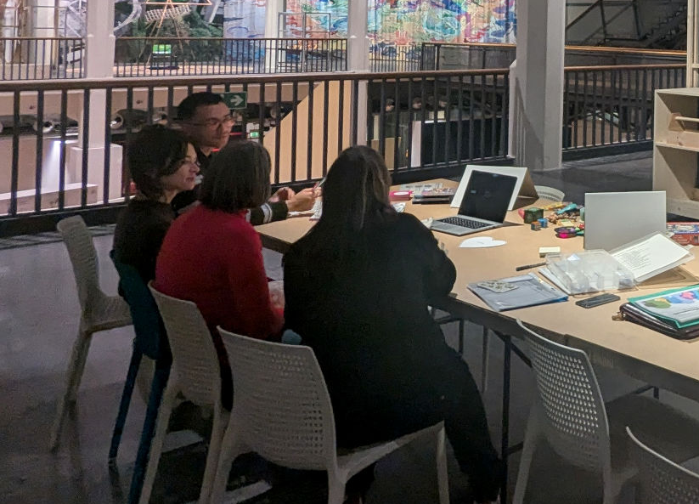
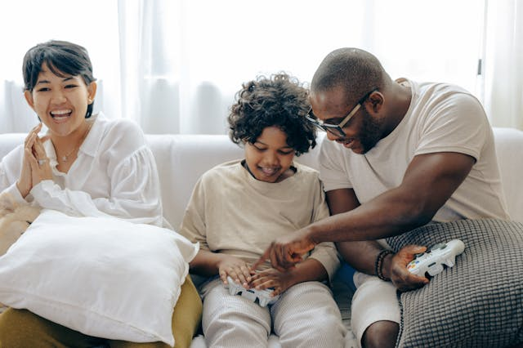
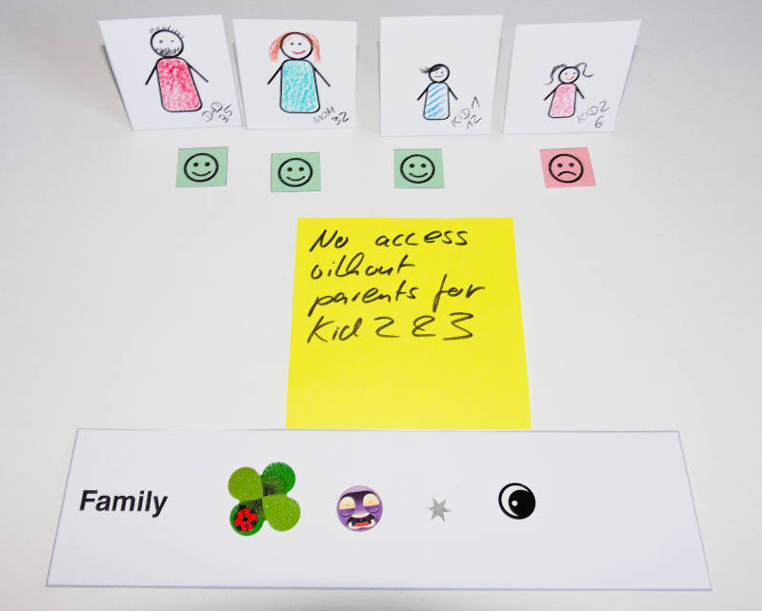
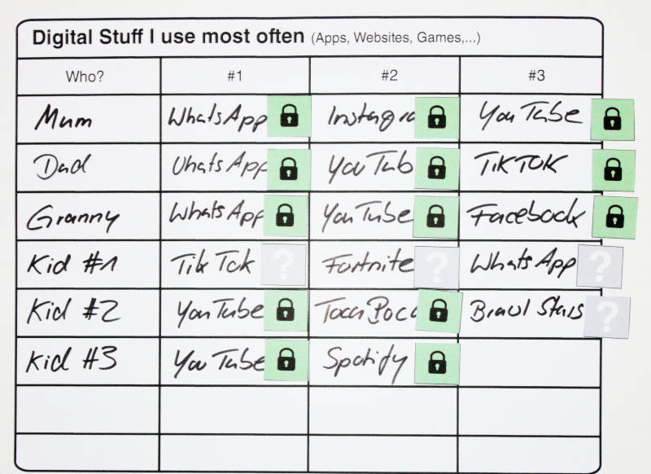
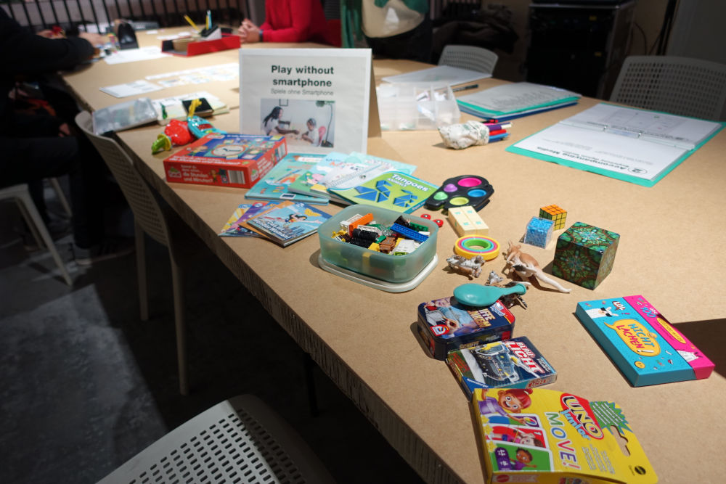

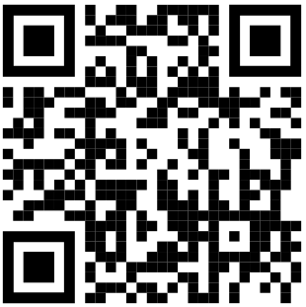

Familab
The media lab for families
Research together and have fun
Our Goal
We learn: Which digital topics are important for families?
We help: How to use digital media well and without arguments.
We show: Exciting games for children without smartphones.
Who Can Join?
Families with children between the ages of 0 and 18.
How Does it Work?
You come to us and do a workshop. The workshop lasts 20-30 minutes. You talk to a specialist about digital media:
Which devices and apps do you use?
How do you use smartphones, tablets,...?
What rules do you have in your family?
Which questions do you have?
You'll get tips and ideas for at home. You can try out all the ideas for playing.
With your help, we can also give other families good and up-to-date tips on our website: https://familab.mkteam.org/tipps/
Make an appointment with [Name]: [E-mail address]
Further information: www.familienlabor.mkteam.org/
Durchführung des Projekts im Rahmen des
Erasmus+-Projekts ScieCitizens 2.0 www.scie-citizens.org
Medienkompetenz Team e.V. - Sophienstraße 120 - 76135 Karlsruhe - Tel: 0162-9231715

